Slide 1
Australia’s Cyber Security
Sector Competitiveness
Plan 2023
Supporting the development of a vibrant and globally competitive Australian cyber security sector

Slide 2


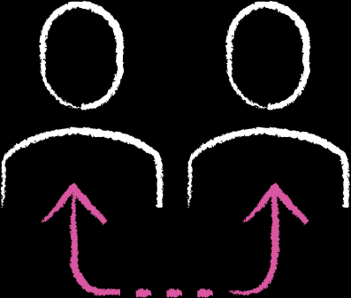

2023 highlights
Growth
Australia’s cyber security sector contributed an estimated AU$6.9 billion to the country‘s Gross Domestic Product (GDP). | The Gross Value Added (GVA) of the cyber security sector to the Australian economy increased by approximately 60 percent from AU$2.44 billion in 2022 to approximately AU$3.99 billion. | There are over 315 cyber security companies in Australia, an increase of 8.25 percent from 2022, with the average age being 5.5 years. | 50 percent of cyber security companies are exporting globally.

Slide 3
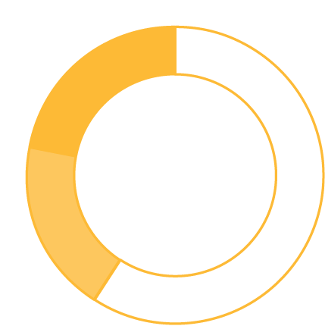



2023 highlights
Workforce
A total of 125,791 people were employed in the Australian cyber security workforce in 2022.
51,309 were identified as Dedicated Roles (41%), an estimated increase of 9.5 percent since the previous year.
Of the Dedicated Roles, 24,254 were identified as Core Roles, requiring technical expertise (19%).
74,482 were identified as Related Roles (59%) requiring cyber skills knowledge.
17 percent of the workforce identify as female in cyber security compared to 0.66 percent identifying as being of Aboriginal and/or Torres Strait Islander heritage and 7 percent identifying as neurodivergent in the technology sector.
The salaries of Australian advertised cyber security positions in the private sector averaged AU$124,331. The equivalent in the public sector was AU$119,694.
Since 2019, enrolments in security science degrees have increased by
30 percent per annum.
The global cyber security workforce reached a historic high of
5.5 million professionals, marking an increase of 440,000 positions compared to 2022, representing an 8.7 percent surge.

Slide 4
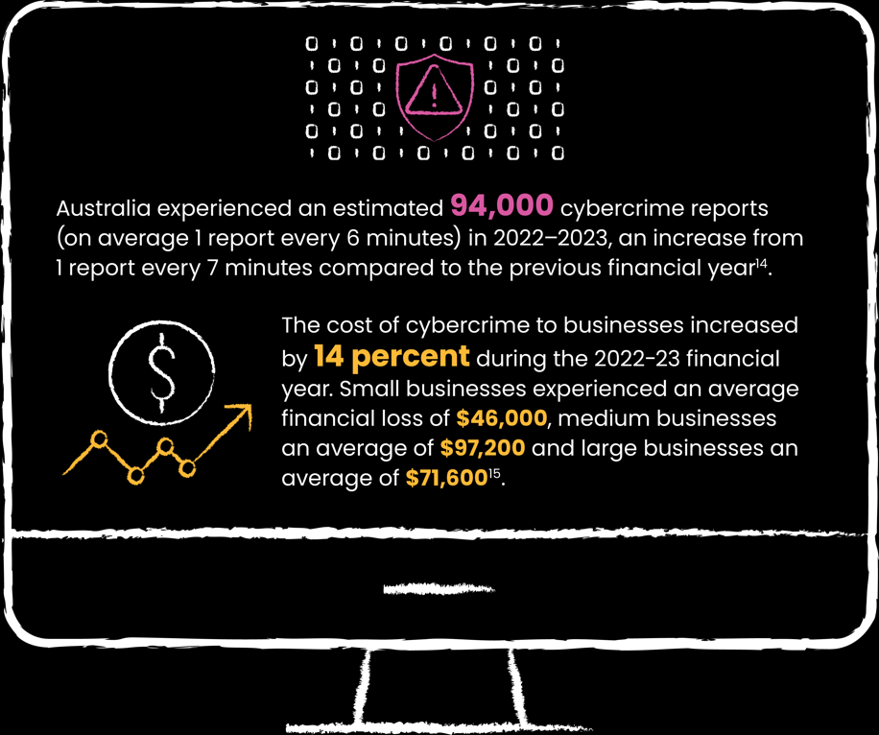
2023 highlights
Cybercrime

Slide 5
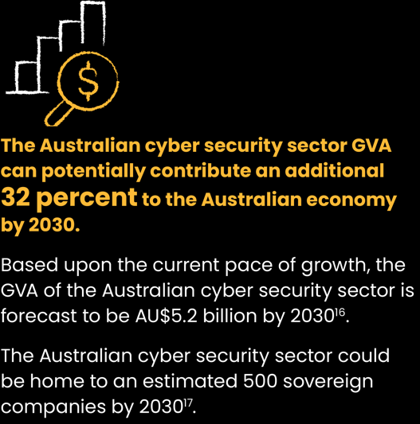
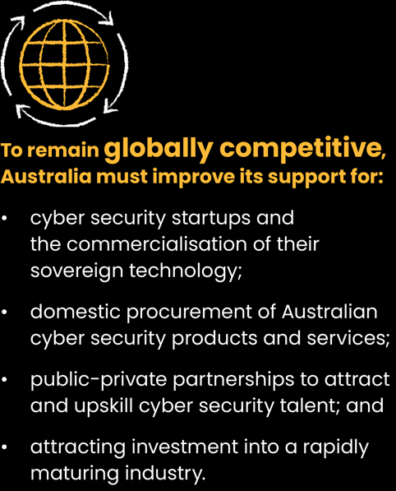
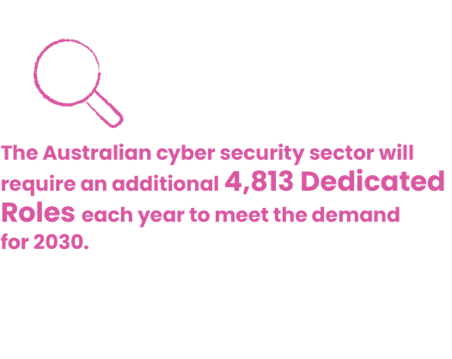
Outlook for 2030

Slide 6

Chapter 1:
The global outlook for cyber security

Slide 7

Chapter 1
The global outlook for cyber security
In 2023, Australia is ranked seventh globally in terms of revenue growth rate, in comparison to 2022 where it was ranked ninth globally. | The cost of global cybercrime has increased by an estimated 176.27 percent from US $2.95 trillion in 2020 to US $8.15 trillion in 2023. | In 2023, the global cyber security workforce reached a historic high of 5.5 million professionals, marking a remarkable increase of 440,000 positions compared to 2022, representing an 8.7 percent surge. | Investment in National Cyber Security Strategies varies significantly on a per capita basis; from US $0.97 in New Zealand to US $41.56 for the United Kingdom. Australia sits at US $15.10 on aper capita basis.

Slide 8

Chapter 2:
Potential growth opportunities for Australia

Slide 9
Chapter 2
Potential growth opportunities for Australia
 | Australia’s cyber security sector generated an estimated AU $3.99 billion of Gross Value Added (GVA) in 2023, up from AU $2.4 billion in 2022. |  | The frequency and severity of cybercrime has risen.
 | There are over 315 cyber security firms in Australia, with 83 percent located in eastern states. |  | Federal government strengthens cyber security policies, strategies and frameworks.
 | The demand for cyber security professionals continues to widen the skilled workforce gap. |  | States and territories are developing their own communities to foster innovation.

Slide 10

Chapter 3:
Challenges to sector growth

Slide 11
Chapter 3
Challenges to sector growth
The Australian cyber security sector GVA could contribute an additional 32 percent to the Australian economy by 2030. | The Australian cyber security sector could be home to approximately 500 sovereign companies by 2030. | The Australian cyber security sector will need a potential skilled workforce of 85,000 Dedicated Roles in 2030. | The Australian cyber security industry is maturing rapidly and will need to attract investors and support innovation to remain competitive.

Slide 12

Chapter 4:
Actions to build a more competitive cyber security sector

Slide 13
Chapter 4
Actions to build a more competitive cyber security sector
Remove growth hurdles for cyber security startups to increase the commercialisation of sovereign technology. | Prioritise domestic procurement of cyber security products and services through a ‘buy Australian first’ approach. | Attract investment and improve innovation to support a rapidly maturing cyber security industry.

Slide 14
For more information and to read the full report, visit www.austcyber.com.

